Slide 1
Chapter 8: Deadlocks

Slide 2
Chapter Objectives
To develop a description of deadlocks, which prevent sets of concurrent processes from completing their tasks.
To present a number of different methods for preventing or avoiding deadlocks in a computer system.

Slide 3
Deadlock Example
/* thread one runs in this function */
void *do_work_one(void *param)
{
pthread_mutex_lock(&first_mutex);
pthread_mutex_lock(&second_mutex);
/** * Do some work */
pthread_mutex_unlock(&second_mutex);
pthread_mutex_unlock(&first_mutex);
pthread_exit(0);
}
/* thread two runs in this function */
void *do_work_two(void *param)
{
pthread_mutex_lock(&second_mutex);
pthread_mutex_lock(&first_mutex);
/** * Do some work */
pthread_mutex_unlock(&first_mutex);
pthread_mutex_unlock(&second_mutex);
pthread_exit(0);
}

Slide 4
System Model
System consists of resources.
Resource types R₁, R₂, . . ., R_{m}
    CPU cycles, memory space, I/O devices.
Each resource type R_{i} has W_{i} instances.
Each process utilizes a resource as follows:
  request
  use
  release

Slide 5
Deadlock Characterization
Deadlock can arise if four conditions hold simultaneously:
Mutual exclusion: only one process at a time can use a resource.
Hold and wait: a process holding at least one resource is waiting to acquire additional resources held by other processes.
No preemption: a resource can be released only voluntarily by the process holding it, after that process has completed its task.
Circular wait: there exists a set {P₀, P₁, …, P_{n}} of waiting processes such that P₀ is waiting for a resource that is held by P₁, P₁ is waiting for a resource that is held by P₂, …, P_{n–1} is waiting for a resource that is held by P_{n}, and P_{n} is waiting for a resource that is held by P₀.

Slide 6
Resource-Allocation Graph
A set of vertices V and a set of edges E.
V is partitioned into two types:
  P = {P₁, P₂, …, P_{n}}, the set consisting of all the processes in the system.
  R = {R₁, R₂, …, R_{m}}, the set consisting of all resource types in the system.
request edge – directed edge P_{i} → R_{j}
assignment edge – directed edge R_{j} → P_{i}

Slide 7



Resource-Allocation Graph (Cont.)
Process:
Resource Type with 4 instances:
P_{i} requests instance of R_{j} :
P_{i} is holding an instance of R_{j} :
P_{i}
R_{j}
P_{i}
R_{j}

Slide 8

Example of a Resource Allocation Graph

Slide 9

Resource Allocation Graph With A Deadlock

Slide 10

Graph With A Cycle But No Deadlock

Slide 11
Basic Facts
If graph contains no cycles ⇒ no deadlock.
If graph contains a cycle ⇒
  if only one instance per resource type, then deadlock.
  if several instances per resource type, possibility of deadlock.

Slide 12
Methods for Handling Deadlocks
Ensure that the system will never enter a deadlock state:
  Deadlock prevention.
  Deadlock avoidance.
Allow the system to enter a deadlock state and then recover.
  Deadlock detection needed.
Ignore the problem and pretend that deadlocks never occur in the system; used by most operating systems, including UNIX.

Slide 13
Deadlock Prevention
Basic principle: restrain the ways request can be made.
Mutual Exclusion – not required for sharable resources (e.g., read-only files); must hold for non-sharable resources
Hold and Wait – must guarantee that whenever a process requests a resource, it does not hold any other resources.
  Require process to request and be allocated all its resources before it begins execution or allow process to request resources only when the process has none allocated to it.
  Low resource utilization; starvation possible.

Slide 14
Deadlock Prevention (Cont.)
No Preemption –
  If a process that is holding some resources requests another resource that cannot be immediately allocated to it, then all resources currently being held are released.
  Preempted resources are added to the list of resources for which the process is waiting.
  Process will be restarted only when it can regain its old resources, as well as the new ones that it is requesting.
Circular Wait – impose a total ordering of all resource types and require that each process requests resources in an increasing order of enumeration.

Slide 15
Deadlock Avoidance
Requires that the system has some additional a priori information
available:
Simplest and most useful model requires that each process declare the maximum number of resources of each type that it may need.
The deadlock-avoidance algorithm dynamically examines the resource-allocation state to ensure that there can never be a circular-wait condition.
Resource-allocation state is defined by the number of available and allocated resources, and the maximum demands of the processes.

Slide 16
Safe State
A state is safe if the system can allocate resources to each thread (up t its maximum) in some order and still avoid a deadlock.
When a process requests an available resource, system must decide if immediate allocation leaves the system in a safe state.
System is in safe state if there exists a sequence <P₁, P₂, …, P_{n}> of all the processes in the systems such that for each P_{i}, the resources that P_{i} can still request can be satisfied by currently available resources + resources held by all the P_{j}, with j < I
That is:
  If P_{i} resource needs are not immediately available, then P_{i} can wait until all P_{j} have finished.
  When P_{j} is finished, P_{i} can obtain needed resources, execute, return allocated resources, and terminate.
  When P_{i} terminates, P_{i +1} can obtain its needed resources, and so on.

Slide 17
Basic Facts
If a system is in safe state ⇒ no deadlocks.
If a system is in unsafe state ⇒ possibility of deadlock.
Avoidance ⇒ ensure that a system will never enter an unsafe state.

Slide 18

Safe, Unsafe, Deadlock State

Slide 19
Avoidance Algorithms
Single instance of a resource type:
  Use a resource-allocation graph.
Multiple instances of a resource type:
  Use the banker’s algorithm.

Slide 20
Resource-Allocation Graph Scheme
Claim edge P_{i} → R_{j} indicated that process P_{j} may request resource R_{j}; represented by a dashed line.
Claim edge converts to request edge when a process requests a resource.
Request edge converted to an assignment edge when the resource is allocated to the process.
When a resource is released by a process, assignment edge reconverts to a claim edge.
Resources must be claimed a priori in the system.

Slide 21

Resource-Allocation Graph

Slide 22

Unsafe State In Resource-Allocation Graph

Slide 23
Resource-Allocation Graph Algorithm
Suppose that process P_{i} requests a resource R_{j}
The request can be granted only if converting the request edge to an assignment edge does not result in the formation of a cycle in the resource allocation graph.
We check for safety by using a cycle-detection algorithm.

Slide 24
Banker’s Algorithm
Multiple instances.
The name of this algorithm was chosen because it could be used in a banking system to ensure that the bank never allocated its available cash so that it could no longer satisfy the need of all its customers.
Each process must a priori claim maximum use.
When a process requests a resource, it may have to wait.
When a process gets all its resources it must return them in a finite amount of time.

Slide 25
Data Structures for the Banker’s Algorithm
Let n = number of processes, and m = number of resources types
Available: Vector of length m. If available [j] = k, there are k instances of resource type R_{j} available.
Max: n x m matrix. If Max [i,j] = k, then process P_{i} may request at most k instances of resource type R_{j}
Allocation: n x m matrix. If Allocation[i,j] = k then P_{i} is currently allocated k instances of R_{j}
Need: n x m matrix. If Need[i,j] = k, then P_{i} may need k more instances of R_{j} to complete its task.
    Need [i,j] = Max[i,j] – Allocation [i,j]

Slide 26
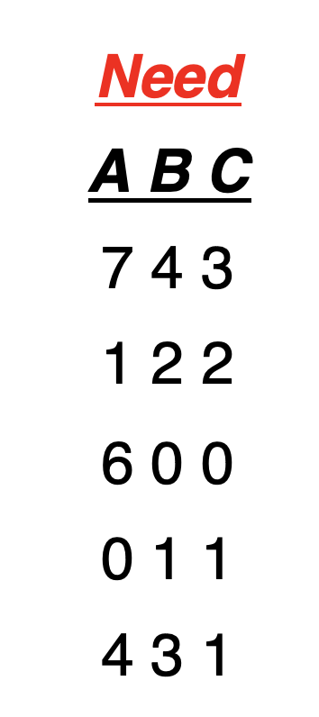
Data Structures for the Banker’s Algorithm Example
Snapshot at time T₀:
Allocation Max Available
A B C A B C A B C
P₀ 0 1 0 7 5 3 3 3 2
P₁ 2 0 0 3 2 2
P₂ 3 0 2 9 0 2
P₃ 2 1 1 2 2 2
P₄ 0 0 2 4 3 3

Slide 27
Safety Algorithm
We can now present the algorithm for finding out whether a system is in a safe state. This algorithm can be described as follows:
1. Let Work and Finish be vectors of length m and n, respectively.
Initialize:
Work = Available
Finish [i] = false for i = 0, 1, …, n - 1
2. Find an i such that both:
  (a) Finish [i] = false
  (b) Need_{i} ≤ Work
  If no such i exists, go to step 4.
3. Work = Work + Allocation_{i}
Finish[i] = true
go to step 2.
4. If Finish [i] == true for all i, then the system is in a safe state.

Slide 28
Example of Banker’s Algorithm
5 processes P₀ through P₄;
3 resource types:
A (10 instances), B (5 instances), and C (7 instances)
Snapshot at time T₀:
Allocation Max Available
A B C A B C A B C
P₀ 0 1 0 7 5 3 3 3 2
P₁ 2 0 0 3 2 2
P₂ 3 0 2 9 0 2
P₃ 2 1 1 2 2 2
P₄ 0 0 2 4 3 3

Slide 29
Example (Cont.)
The content of the matrix Need is defined to be Max – Allocation
Need
A B C
P₀ 7 4 3
P₁ 1 2 2
P₂ 6 0 0
P₃ 0 1 1
P₄ 4 3 1
The system is in a safe state since the sequence < P₁, P₃, P₄, P₂, P₀> satisfies safety criteria.

Slide 30
Resource-Request Algorithm for Process P_{i}
Next, we describe the algorithm for determining whether requests can be safely granted.
Request_{i} = request vector for process P_{i} If Request_{i} [j] = k then process P_{i} wants k instances of resource type R_{j}
  1. If Request_{i} ≤ Need_{i} go to step 2. Otherwise, raise error condition, since process has exceeded its maximum claim.
  2. If Request_{i} ≤ Available, go to step 3. Otherwise, P_{i} must wait, since resources are not available.
  3. Pretend to allocate requested resources to P_{i} by modifying the state as follows:
      Available = Available – Request_{i};
      Allocation_{i} = Allocation_{i} + Request_{i};
      Need_{i} = Need_{i} – Request_{i};
    If safe ⇒ the resources are allocated to P_{i}
    If unsafe ⇒ P_{i} must wait, and the old resource-allocation state is restored.

Slide 31
Example: P₁ Request (1,0,2)
Allocation Need Available
A B C A B C A B C
P₀ 0 1 0 7 4 3 2 3 0
P₁ 3 0 2 0 2 0
P₂ 3 0 2 6 0 0
P₃ 2 1 1 0 1 1
P₄ 0 0 2 4 3 1
Executing safety algorithm shows that sequence < P₁, P₃, P₄, P₀, P₂> satisfies safety requirement
Can request for (3,3,0) by P₄ be granted?
Can request for (0,2,0) by P₀ be granted?

Slide 32
Deadlock Detection
Allow system to enter deadlock state.
Detection algorithm.
Recovery scheme.

Slide 33
Single Instance of Each Resource Type
Maintain wait-for graph.
  Nodes are processes.
  P_{i} → P_{j} if P_{i} is waiting for P_{j}
Periodically invoke an algorithm that searches for a cycle in the graph. If there is a cycle, there exists a deadlock.

Slide 34

Resource-Allocation Graph and Wait-for Graph
Resource-Allocation Graph
Corresponding wait-for graph

Slide 35
Several Instances of a Resource Type
Available: A vector of length m indicates the number of available resources of each type.
Allocation: An n x m matrix defines the number of resources of each type currently allocated to each process.
Request: An n x m matrix indicates the current request of each process. If Request [i][j] = k, then process P_{i} is requesting k more instances of resource type R_{j}

Slide 36
Detection Algorithm
1. Let Work and Finish be vectors of length m and n, respectively. Initialize:
  (a) Work = Available
  (b) For i = 1,2, …, n, if Allocation_{i} ≠ 0, then
  Finish[i] = false; otherwise, Finish[i] = true
2. Find an index i such that both:
  (a) Finish[i] == false
  (b) Request_{i} ≤ Work
  If no such i exists, go to step 4

Slide 37
Detection Algorithm (Cont.)
3. Work = Work + Allocation_{i}
Finish[i] = true
go to step 2
4. If Finish[i] == false, for some i, 1 ≤ i ≤ n, then the system is in deadlock state. Moreover, if Finish[i] == false, then P_{i} is deadlocked.

Slide 38
Example of Detection Algorithm
Five processes P₀ through P₄
three resource types:
A (7 instances), B (2 instances), and C (6 instances)
Snapshot at time T₀:
Allocation Request Available
A B C A B C A B C
P₀ 0 1 0 0 0 0 0 0 0
P₁ 2 0 0 2 0 2
P₂ 3 0 3 0 0 0
P₃ 2 1 1 1 0 0
P₄ 0 0 2 0 0 2
Sequence <P₀, P₂, P₃, P₄, P₁> will result in Finish[i] = true for all i

Slide 39
Example (Cont.)
P₂ requests an additional instance of type C
Request
A B C
P₀ 0 0 0
P₁ 2 0 2
P₂ 0 0 1
P₃ 1 0 0
P₄ 0 0 2
State of system?
  Can reclaim resources held by process P₀, but insufficient resources to fulfill other processes; requests
  Deadlock exists, consisting of processes P₁, P₂, P₃, and P₄

Slide 40
Recovery from Deadlock: Process Termination
Abort all deadlocked processes.
Abort one process at a time until the deadlock cycle is eliminated.
In which order should we choose to abort?
  Priority of the process.
  How long process has computed, and how much longer to completion.
  Resources the process has used.
  Resources process needs to complete.
  How many processes will need to be terminated.
  Is process interactive or batch?

Slide 41
Recovery from Deadlock: Resource Preemption
To eliminate deadlocks using resource preemption, we successively preempt some resources from processes and give these resources other processes until the deadlock is broken.

Slide 42
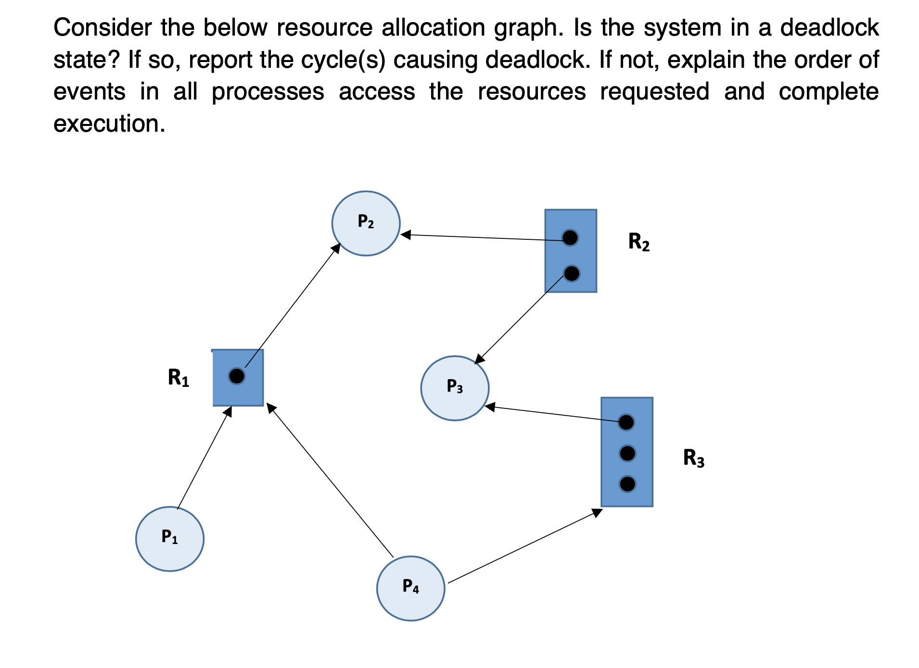
Check Point

Slide 43
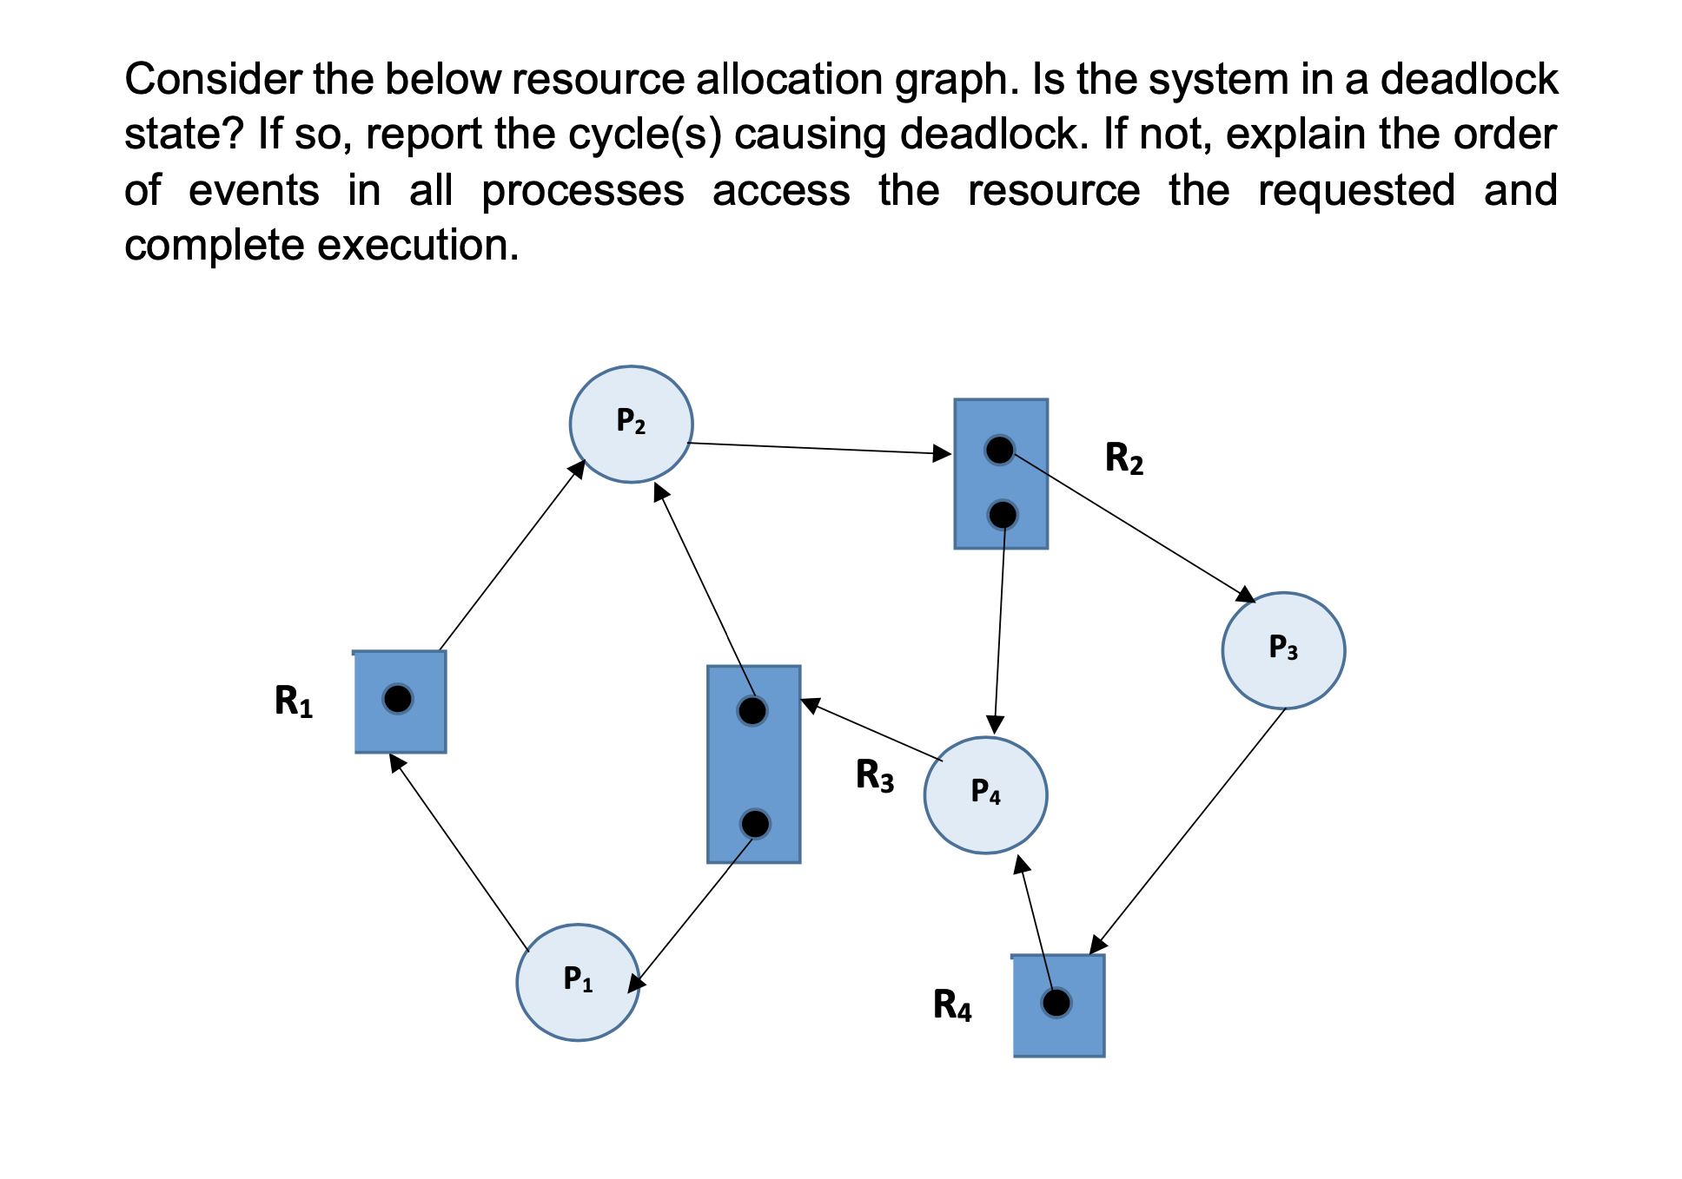
Check Point

Slide 44
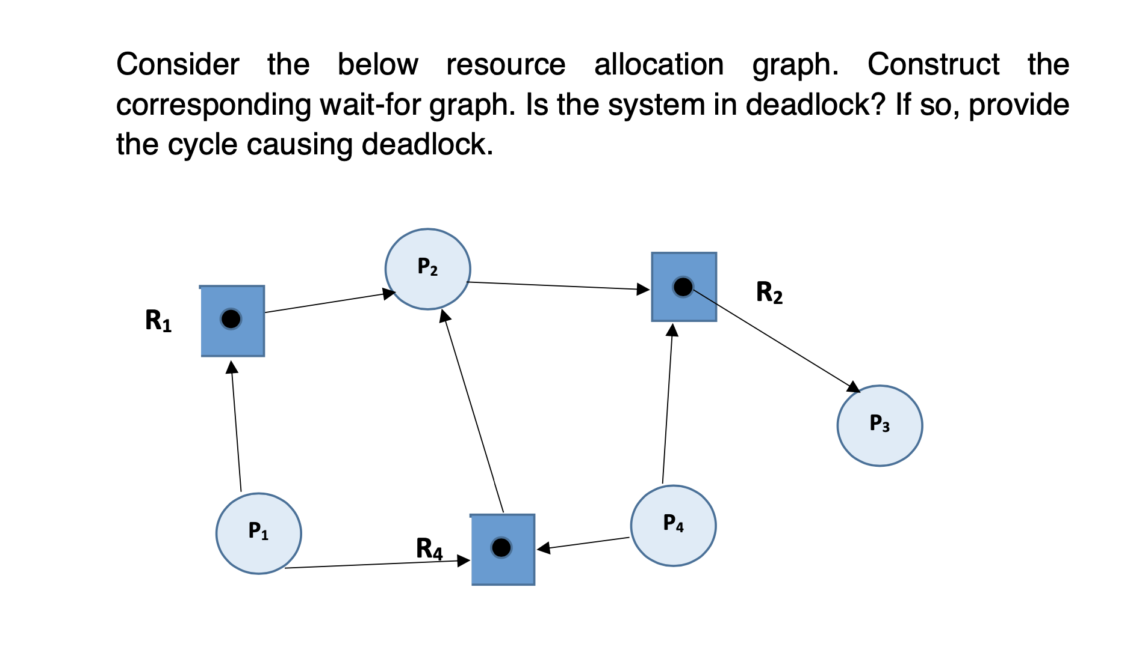
Check Point

Slide 45
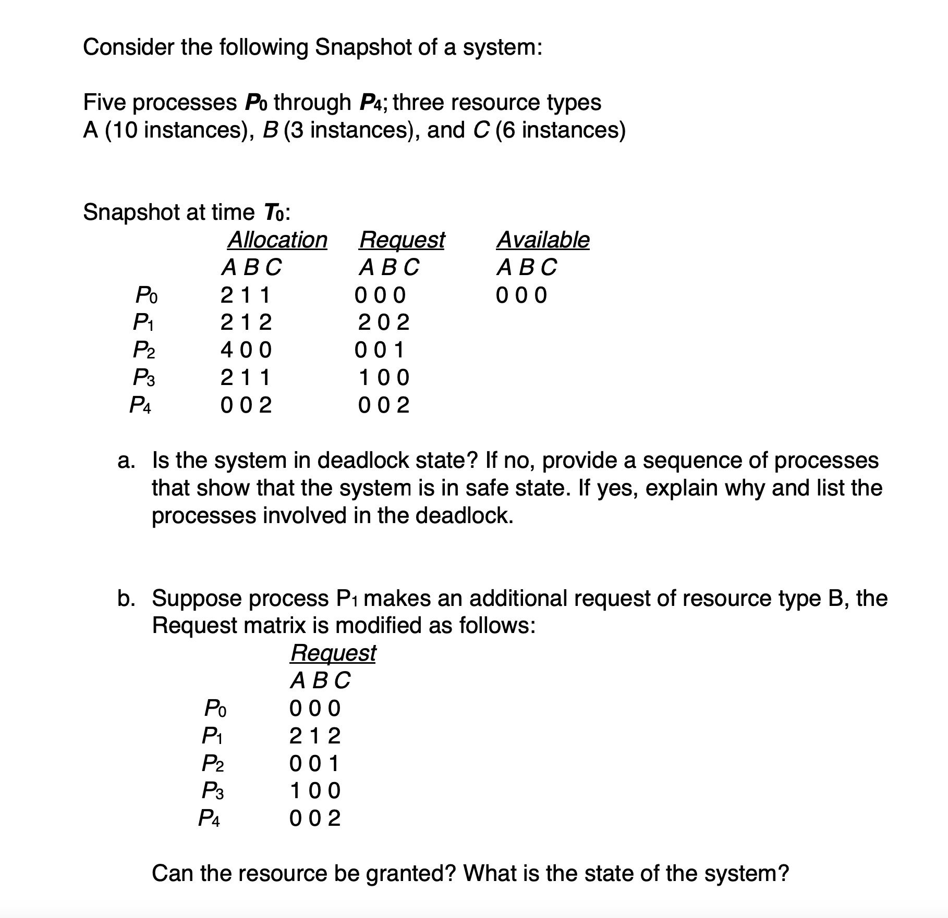
Check Point

Slide 46
End of Chapter 8

